Slide 1


CSE 470 – V, Incremental, Iterative Models
BRAC University

Slide 2


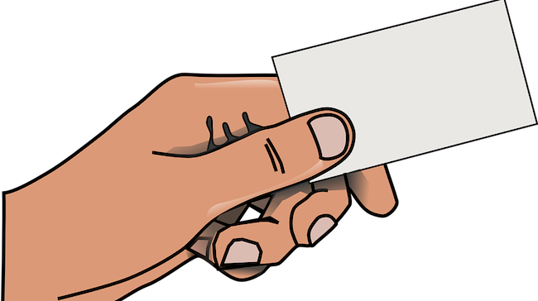
Small Accounting Project
Team Lead

Slide 3


Requirement is Rigid.
Customer asked to emphasize on proper testing of the accounting software…..!!!

Slide 4

V-Model
Its another sequential software development process model. Its also known as an extension of waterfall model, due to providing earlier and detailed software testing.

Slide 5

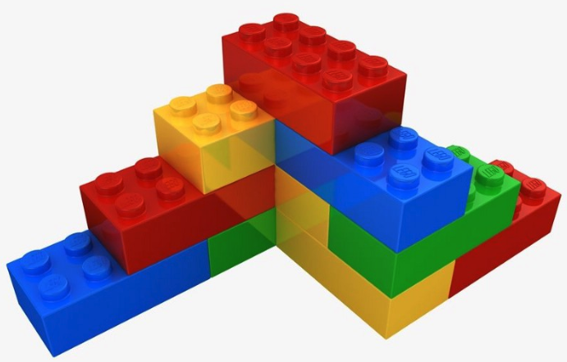
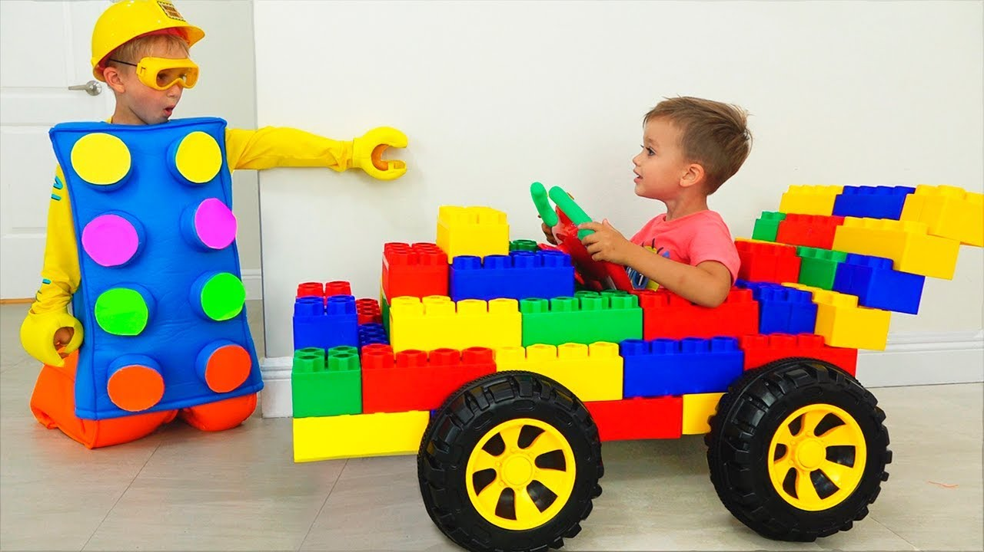
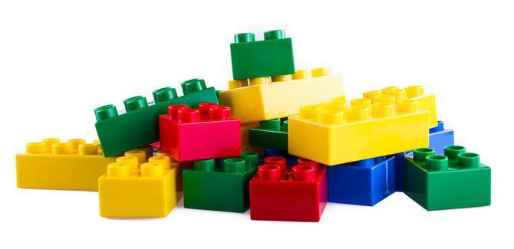

Accpetance
Test Design
Requirement Analysis
Acceptance Testing
System
Test Design
Architecture Design
System Testing
Integration
Test Design
Component/Module Design
Integration Testing
Unit Test Design
Code Generation
Unit Testing

Slide 6
Verification and Validation
Suppose, you have received a request for developing a android app. In this regard, you meet the customers, collected requirements, documented the requirements, created designs to built it and finally coded it as per the design. That means you are trying to follow all standard ways to develop the app rightly.
Building the product in the right way is called “Verification”.
Verification
Validation
After completion of the app coding, we sent it to testing phase. Various tests are performed to ensure whether the app meets the customer requirements. That is you try to check whether the right app is developed.
Building the right product is called “Validation”.

Slide 7
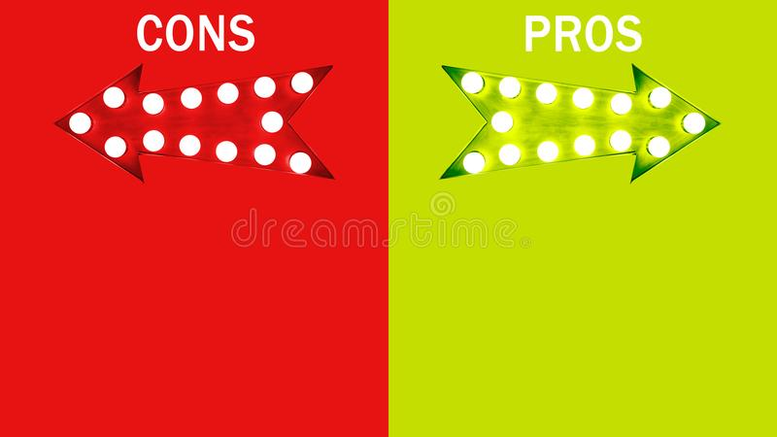
Changes are not welcomed
Software developed at end of all phases, so no dummy prototypes can be found
If any test fails, then test document and code both needs to be updated
Along with waterfall advantages, it emphasizes planning for verification and validation (V&V) of the product from the very beginning of requirement collection.
Test activities planned before testing
Saves time over waterfall, higher chance of success

Slide 8




Sequential Process Model
Customer Don’t Know what they want !!!
Customer know What they Want
Team Lead

Slide 9
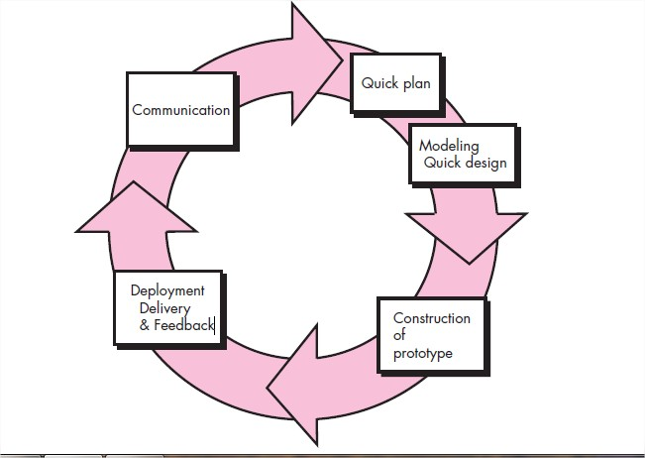
Evolutionary Process Models
Can change requirements as you want.
Can go back to previous phases, such as after coding, we can go back to communication phase for requirement collection again.

Slide 10
Incremental Process Model
A software process model where the software will be delivered in increments
Customer wants to use the software from the very beginning of the project
Customer is well-known about the major requirements
The software is divided into fixed number of increments to be delivered to customers

Slide 11
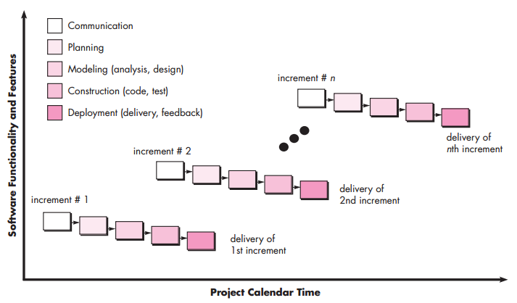
Incremental Process Model

Slide 12
For example, in first increment Login module is delivered. In second increment, another new module such as Navigation module is also added. In third, one more added.
That is, this model “adds onto” new section as increments.
Increment 1
Increment 2
Increment 3
Increment 4
Increment 5

Slide 13
When to use
You are ready with thin slices of the overall software pieces.
Customer wants prototype version of the software from the beginning of the project
Parallel stages such as requirement collection, planning etc. can take place.
Increments needs to be prioritized by customers, so better chance of success
Better for small or medium size projects

Slide 14
Iterative Process Model
A software process model where the software will be delivered in iterations
Customer is not sure about the requirements
Even development team may not be sure about which technology, algorithms may be used.
There is no fixed limit of iterations, that is time is set aside.

Slide 15
For example, in first iteration Login module is delivered. In second iteration, Login module is updated again. In third iteration, Navigation module is added . And in fourth iteration some refinement is done.
That is, this model “changes or reworks” on same section in iterations until customer accepts it.
Iteration 1
Iteration 2
Iteration 3
Iteration 4
Iteration 5

Slide 16
When to use
Requirements are not fixed
Technological tools or requirements are not identified yet.
Instead of fixed time, quality of the features is refined with time
Customer feedbacks with repetitive iterations increase the product quality
Better for long-term and complex projects

Slide 17
Example Case
Being a project manager of a software company, you have got a project request for developing a corona virus awareness app. The customers initially want the app to show testing info, take appointments, visualize affected area data and many more. Currently, the software should support only Bangla language, however English language support can be added later if the app gets promising feedbacks.
In such a case, which would you apply – Waterfall, Incremental or Iterative?

